Slide 1
PRODUCTO DESAROLLADO IN JAVA
SISTEMA DE CONTROL DEL INVENTARIO DE SUPERMERCADOS VIVANDA

Slide 2
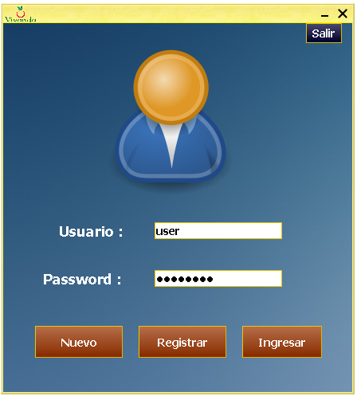
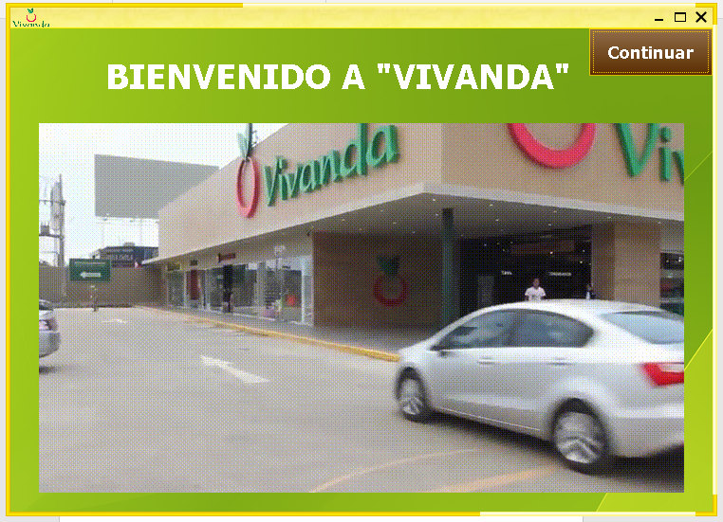
LOG-IN WINDOW
INTRODUCTION WINDOW

Slide 3
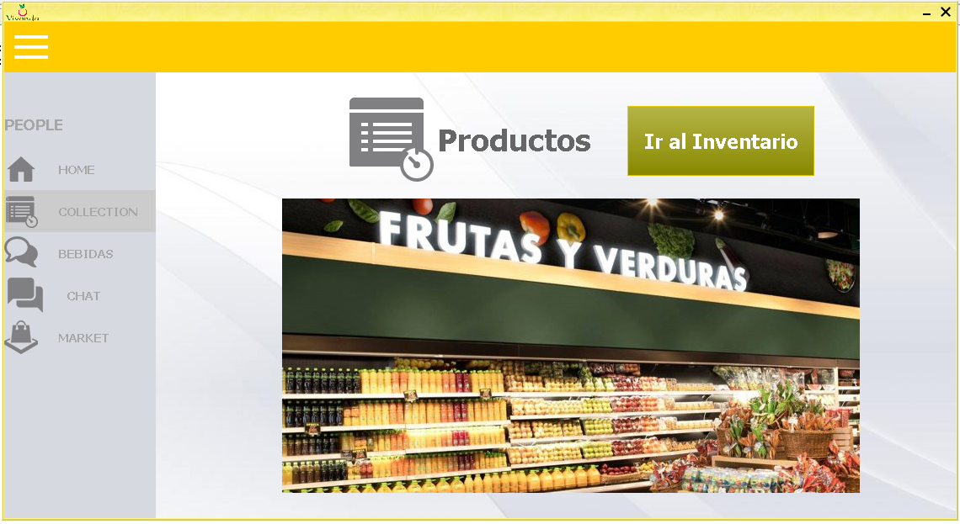
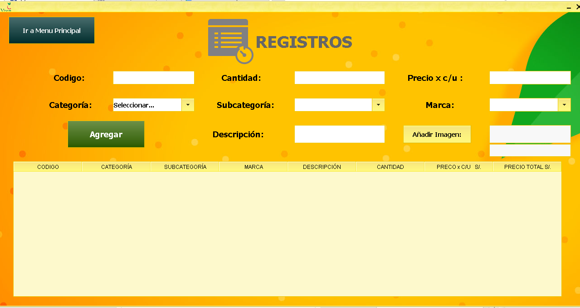
INVENTORY WINDOW
PRODUCT REGISTRATION WINDOW

Slide 4
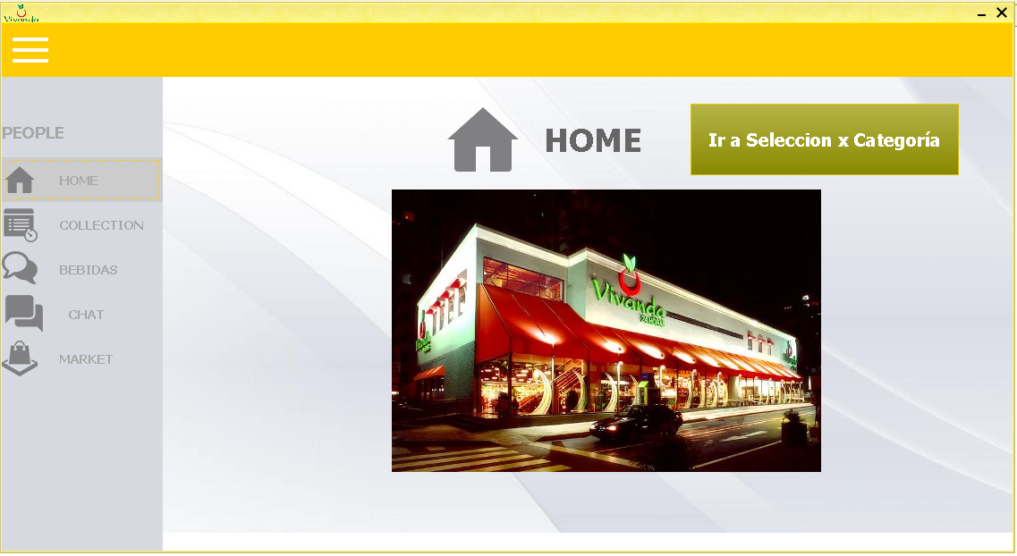
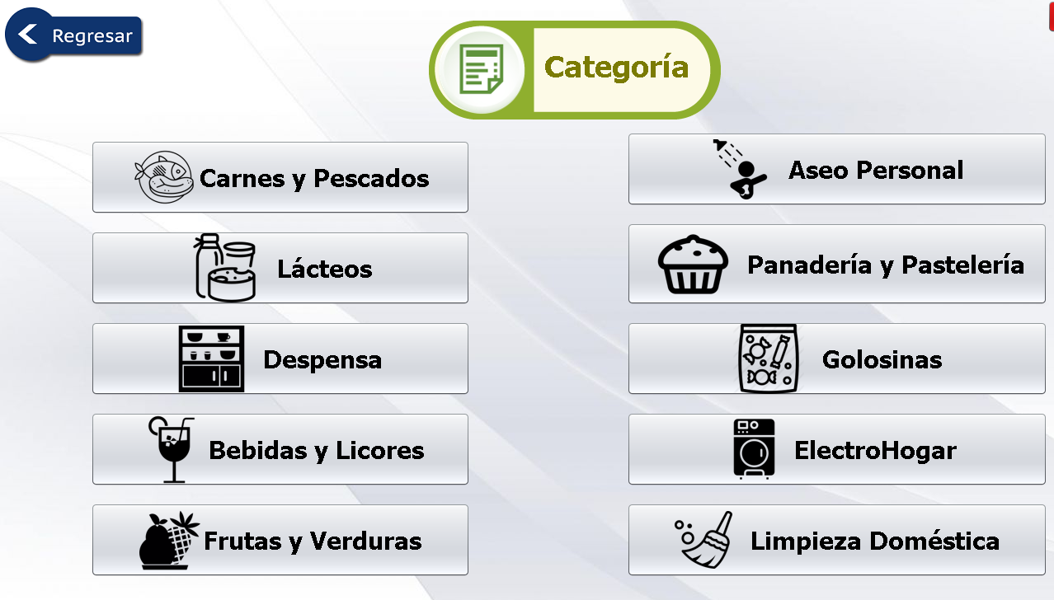
PRINCIPAL WINDOW
CATEGORIES WINDOW

Slide 5
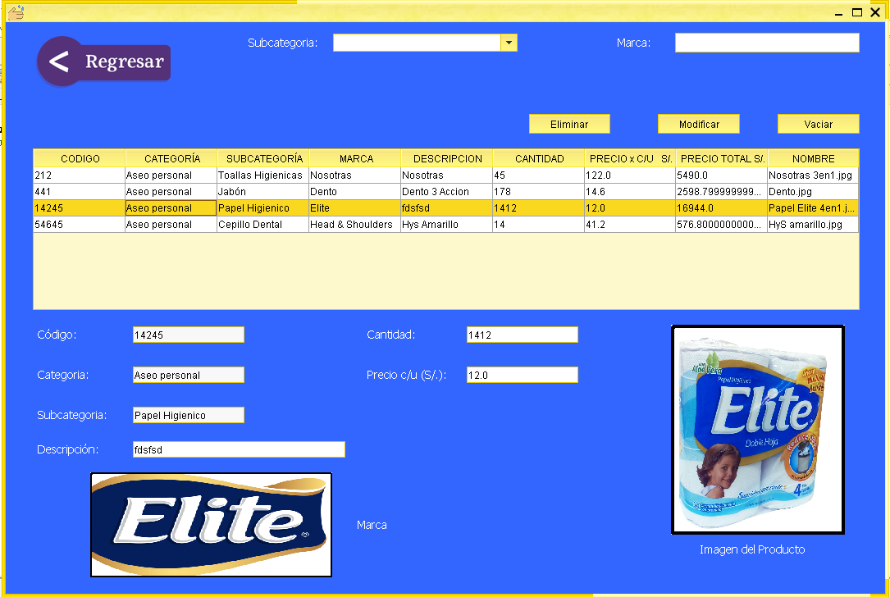
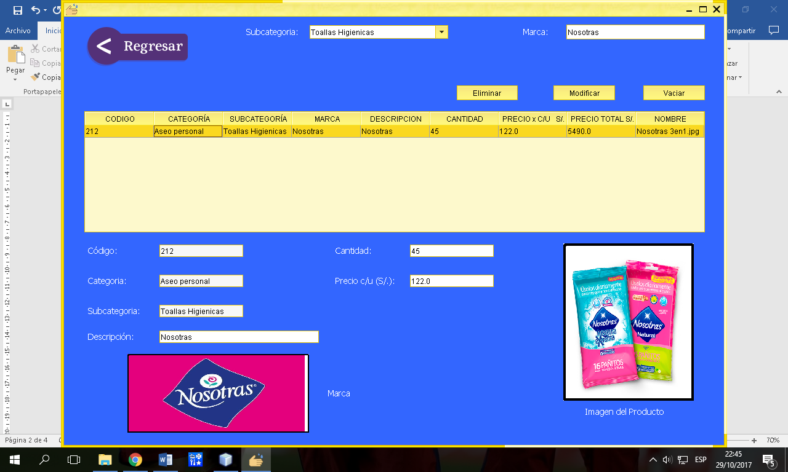
PERSONAL CLEANLINESS WINDOW
FILTER OPTION

